Slide 1
System Panic
By: Evethalie Stlouis and Layla Hoey

Slide 2
Sytems Finished
Player Movement
Free flowing movement in Neighborhood hub worlds
Turn-based point and click movement on tiled game board
Procedurally Generated Neighborhoods (Levels)
Basics of Combat System
Attributes
Stats
Abilities

Slide 3
Procedurally Generated Neighborhoods (Levels)
Levels are procedurally generated at runtime.
Neighborhoods pull from a pool of prefabricated intersections.
These intersections are spliced together to create a city.

Slide 4
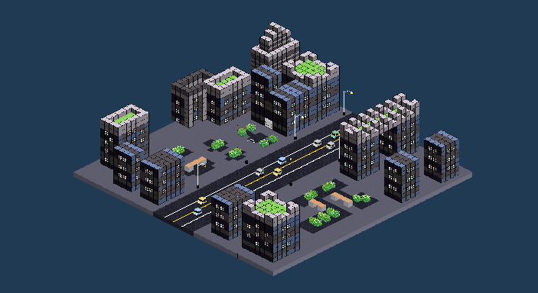
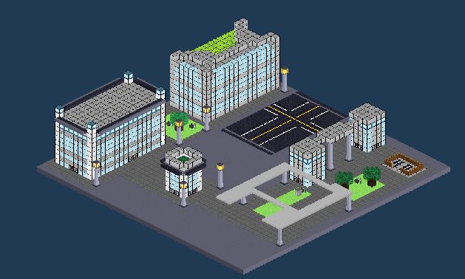
Intersection Prefabs
Examples of some intersection prefabs

Slide 5
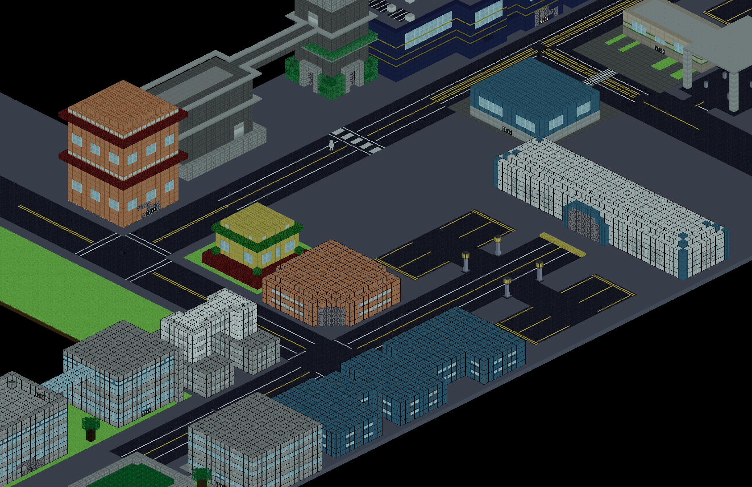
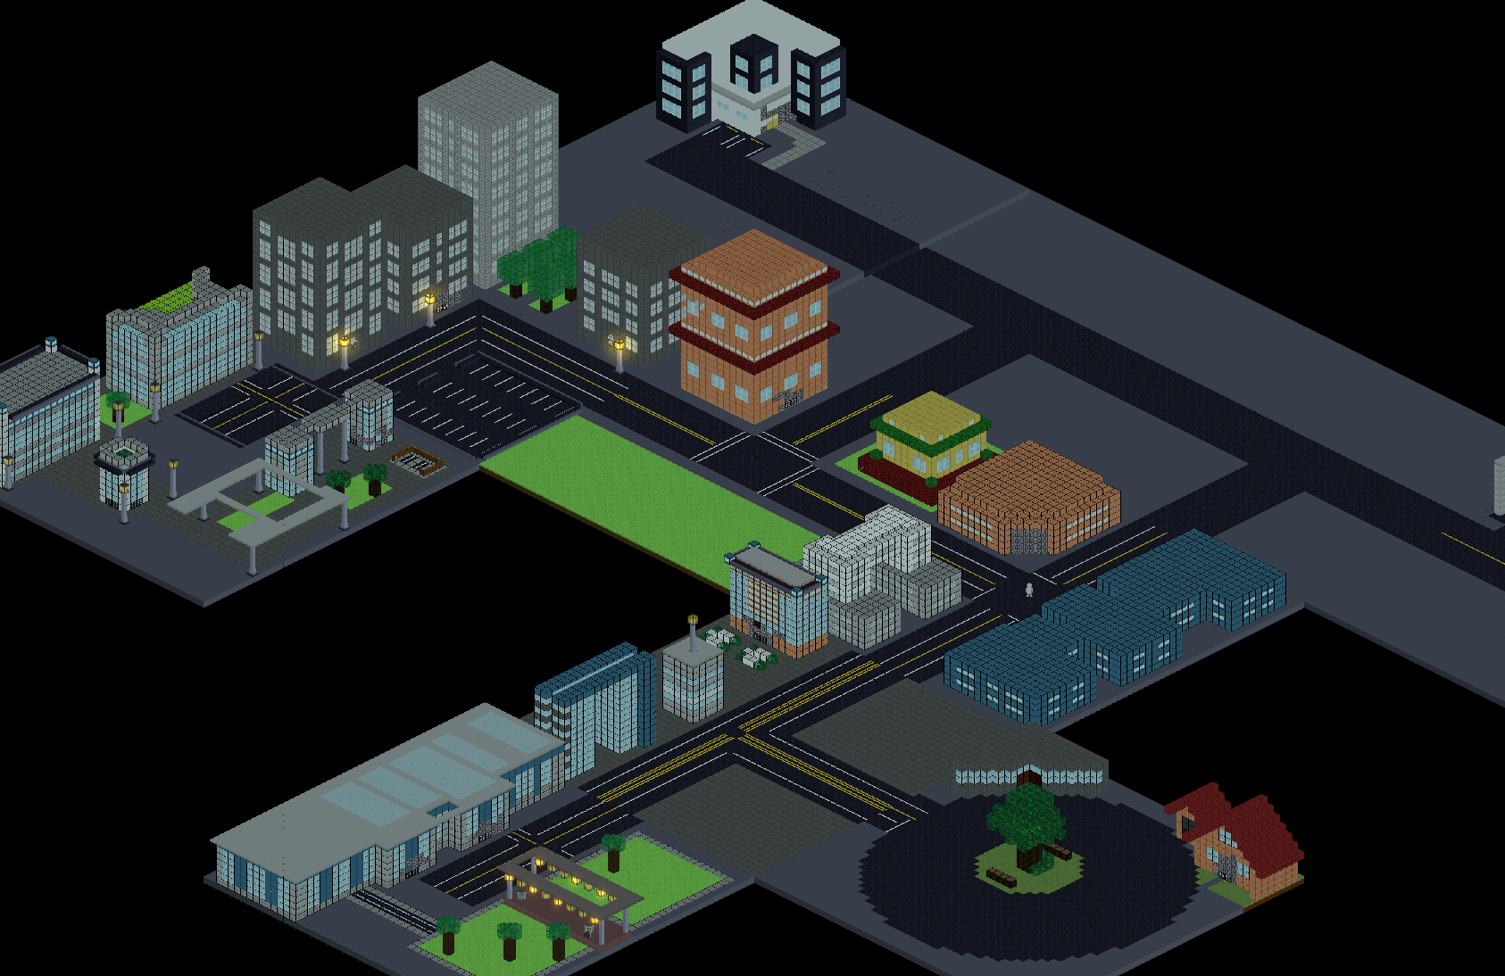
Procedurally Generated Neighborhoods (Levels)

Slide 6
Character Classes
The Player’s Character Class determines their appearance, starting stats, gear rewards, Abilities, Spells
Fighter – Focuses on strength to do high damage
Rogue – Focuses on stamina to wear down enemies and do damage over time
Mage – focuses on intelligence to cast spell to do area-of-effect and multi-enemy damage
Tank- focuses on constitution to outlast enemies

Slide 7
Attributes and Stats
Strength – Attack power and Ability Slots
Dexterity – Stamina and Speed
Constitution – Health and damage reduction
Intelligence – Mana and Spell Slots
Wisdom – Spell Power

Slide 8
Abilities
The core combat element.
Abilities deal damage, heal players, inflict status changes, and more.
Physical Abilities use Stamina
Magical Abilities use Mana
Gain Abilities through Experience, or as a reward for more challenging Dungeons.
We plan to add a skill tree, restricting some abilities depending on Character Class

Slide 9
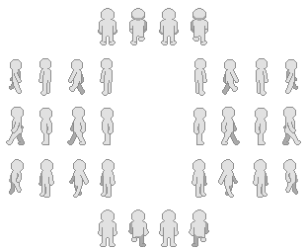
Player
A Basic white player model for skin color and clothing to be layered onto

Slide 10
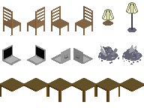
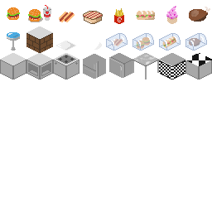
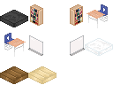
Decor
Décor that will be added into our dungeons next semester

Slide 11

Video { As Fighter }

Slide 12
THANK YOU
Any Questions?

Slide 13

Video { As Mage }

